Slide 1


2025 - 2026

Slide 2
Hello! My name is
[or Our names are]:
[Your name(s)] from [Home country]
Written in your language(s)
Notes:
(For example: How big the cars are! How friendly everyone is.)

Slide 3
What is the Medallion Program?
The Medallion Program is a U.S. Department of State program that
recognizes high schools which welcome exchange students
participating in programs through the State Department’s Bureau of Educational and Cultural Affairs (ECA).
These programs include:
YES – Youth Exchange and Study
FLEX – Future Leaders Exchange Program
CBYX – Congress-Bundestag Youth Exchange
Notes:
(Share your personal answer. For example: I wanted to learn a new language, to meet new people, to have an adventure.)

Slide 4


[Insert name of School]

Slide 5







How did the U.S. school experience impact me [or us]?
Notes:
(What are some of your favorite things in the U.S.? Musicians? Actors? Sports? Traditions? Food?)

Slide 6
Insert photo(s) that represent your experience in the school, if available.
Notes:
(You can answer questions like these: What language(s) do most people speak in your home country? What is the most popular sport? How is your culture different from American culture? You can also talk about other topics you think might be interesting.)

Slide 7
What the AFS Experience
means to me
Notes:
(You can answer questions like these: What is a typical day like at school in your home country? How is your school different from an American school? What do kids usually do after school? Are there sports and/or extracurricular activities?)

Slide 8
(Insert a photo from your experience, perhaps with host family.)
Notes:
(You can answer questions like these: What is your favorite food from home? What is a popular meal in your home country? What do you and your family usually eat for dinner? What do students usually eat for lunch? What foods do you eat at home that might surprise Americans?)

Slide 9
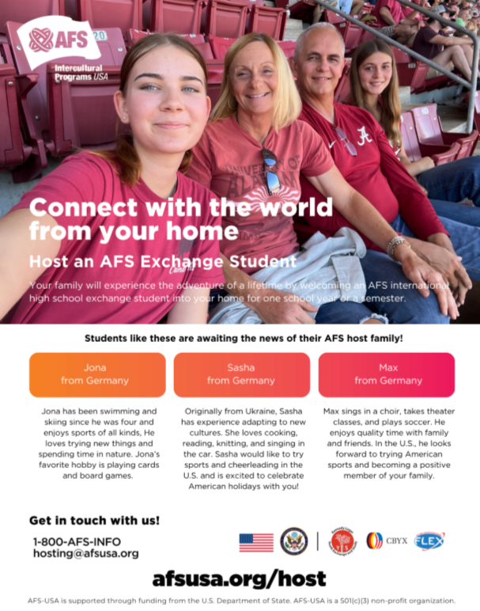
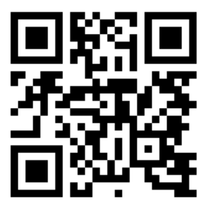
Please keep the Medallion Program alive!
Consider HOSTING a student from a U.S. Department of State funded program during the coming school year.
Notes:
(Share your personal answer. For example: I wanted to learn a new language, to meet new people, to have an adventure.)

Slide 10
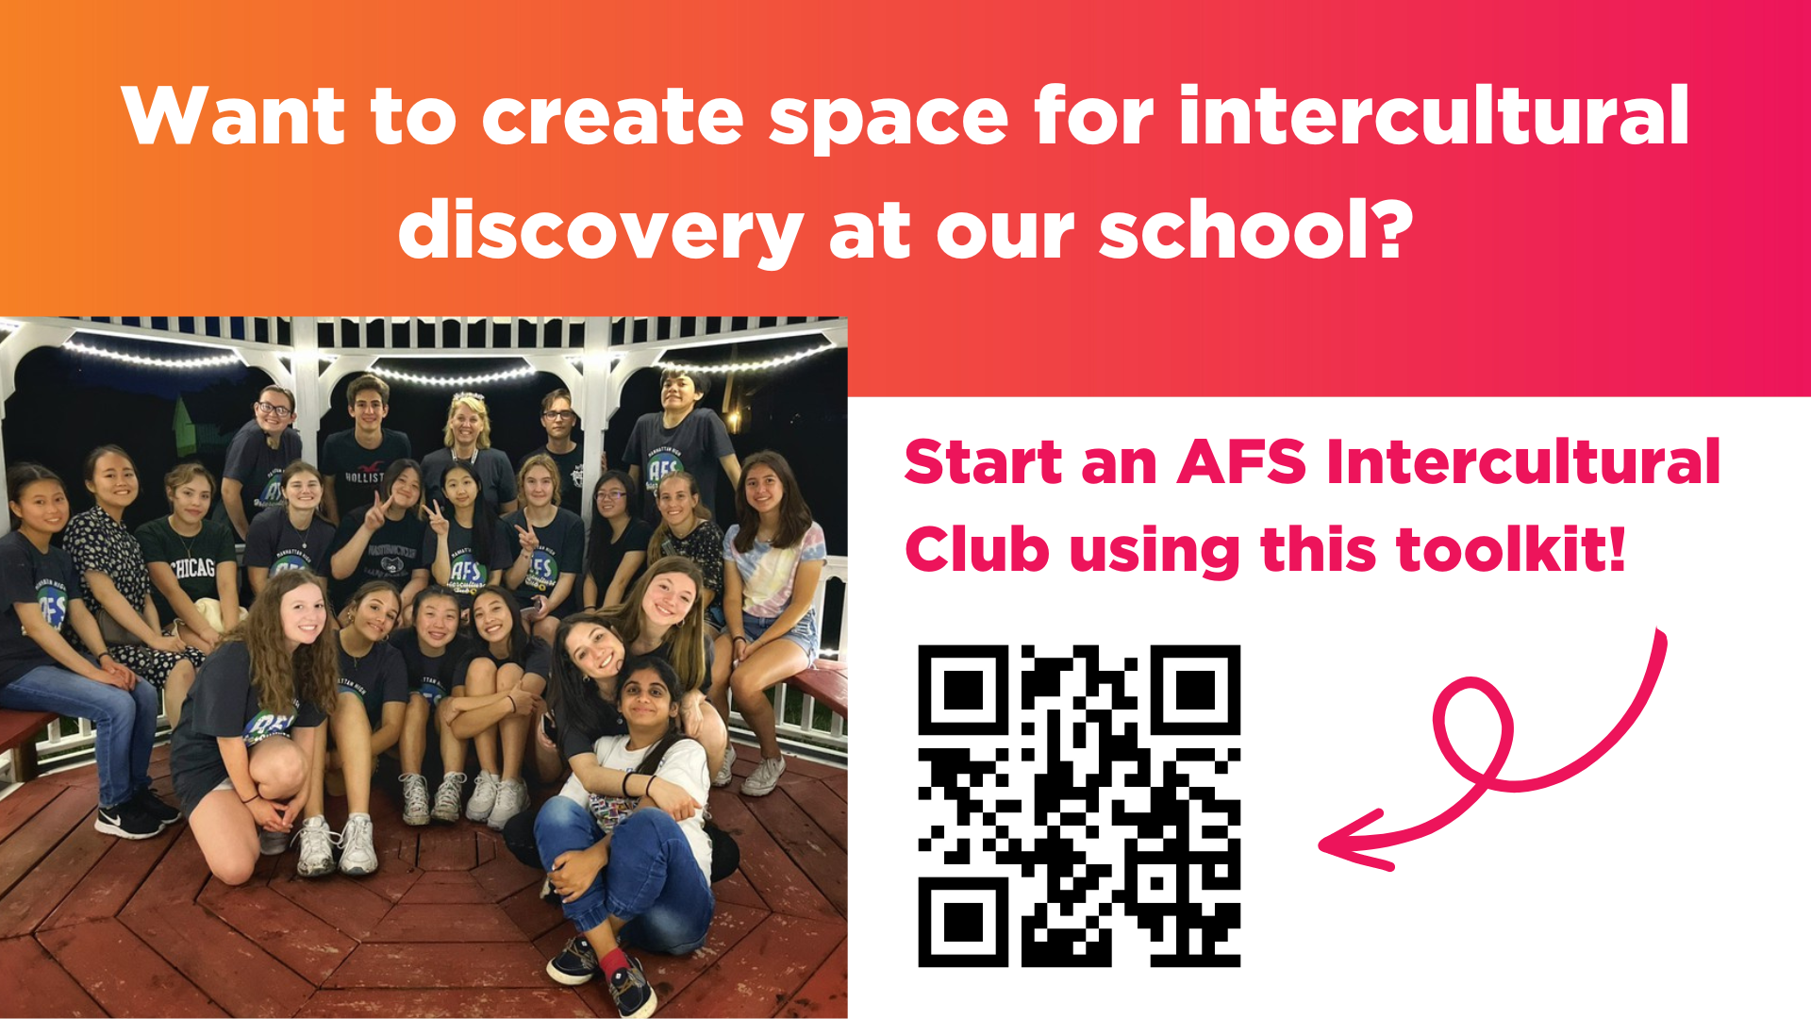
Notes:
Encourage your classmates and teachers to start an AFS Intercultural Club at your school, where AFS students and local students can come together for activities, games, and other fun events to connect across cultures.

Slide 11

Notes:
Encourage your classmates to scan the QR code and learn about studying abroad with AFS-USA!

Slide 12

Notes:
Encourage your teachers to use our intercultural education resources to teach global competency in their classrooms!

Slide 13

Notes:
Encourage your classmates and teachers to follow us on social media to learn more about AFS, hear stories from our community, and find ways to get involved!

Slide 14



Thank you for sharing
your culture and opening
your school to the world!
Notes:
This is a good opportunity to thank anyone who has made you feel welcome, including teachers, host family, friends, AFS Volunteers, etc.

